Slide 1

NETWORKING
Presentation made by: Ms. Archika Bhatia

Slide 2
WHAT IS A NETWORK ?
Network is an interconnected collection of autonomous computers.
Autonomous means that no computer on networks can start, stop or control another.

Slide 3
NEED FOR NETWORKING
RESOURCE SHARING
Makes all programs, data and peripherals available to anyone on the network irrespective of the physical location of resources and the user.
RELIABILITY
A file can have copies on two or three machines so if one of them is unavailable due to any reason, the other copy could be used.
COST FACTOR
Results in less cost consumption because of sharing of resources.
COMMUNICATION MEDIA
It helps in communication between different people located at different places.

Slide 4
Four Basic Elements of Networks:
Protocols (Rules of the road)
Media (Road)
Intermediary Devices(Traffic Controllers)
End Devices(Source/Dest. Computers)

Slide 5
Characteristics of All Networks:
Fault Tolerance (Redundancy)
Scalability (Expansion)
Quality of Service (Does it meet requirements)
Security (Hackers etc.)

Slide 6
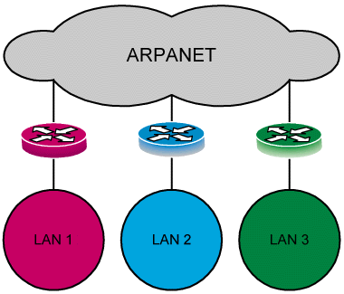
EVOLUTION OF NETWORKING
ARPANET
Advanced Research Projects Administration Network
In mid 1960s at the height of Cold War, the DOD (Department of Defense) wanted a command and control network that could survive a nuclear war.
Traditional circuit-switched telephone networks were considered too vulnerable.
To solve this problem DOD created ARPANET.

Slide 7
TYPES OF NETWORKS
There are three basic types of networks classified on the basis of geographic area.
LAN
MAN
WAN

Slide 8
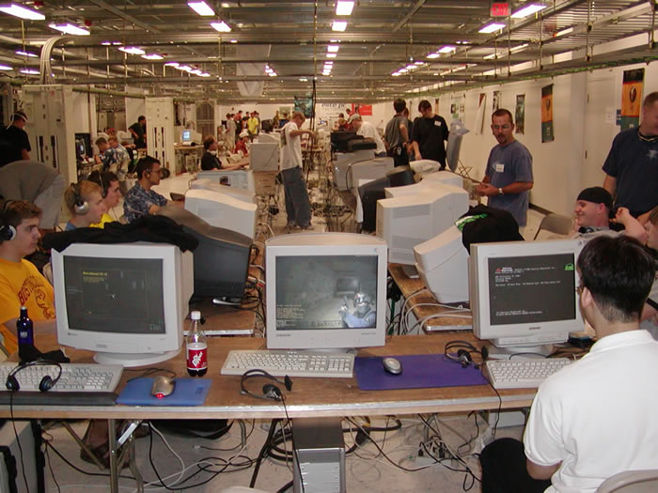
Local Area Network
Smaller networks that are confined to a localised area. ( e.g. an office, building or factory ) are known as LANs.
Metropolitan Area Network
Network spread across a city. E.g Cable T.V.

Slide 9
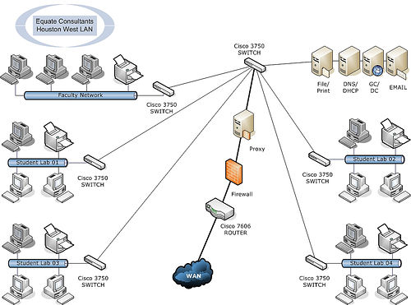
Wide Area Network
Network spread across countries. e,.g. Internet

Slide 10
Difference between LAN and WAN
LAN
Diameter is not more than a few Kms.
A total data rate of at least several Mbps.
Complete ownership by a single organisation.
Low error rates.
WAN
Spans entire countries.
Data rate less than 1 Mbps.
Owned by multiple organisations.
Higher error rate.

Slide 11
Research Exercise: LAN
There are two types of LAN Peer to Peer and Client Server
Using your logbook, research the internet give a description of both, listing the characteristics /advantages/disadvantages of both

Slide 12
SWITCHING TECHNIQUES
There are different ways of sending data across the network.
Circuit Switching
Packet Switching

Slide 13
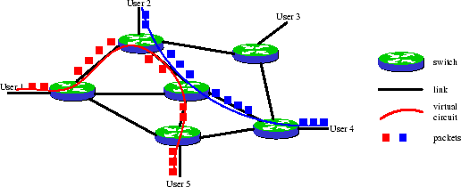
CIRCUIT SWITCHING
In this technique complete physical connection is established between 2 computers and then data is transmitted from the source computer to the destination computer. During the connection establishment, resources are allocated between the caller and the callee.

Slide 14
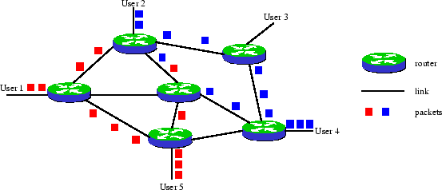
PACKET SWITCHING
Message switching systems are nowadays mostly implemented over PACKET SWITCHING technique.
It works on store and forward principle.
When this form of switching is used, no physical path is established in advance in between sender and receiver. Instead, when the sender has a block of data to be sent, it is stored in the first switching device (i.e. router) then forwarded later at one packet at a time.
A message is divided into small packets of fixed size. Each packet carries the address of the destination
Each packet is processed individually by a router, all packets sent by a host to another host are not guaranteed to use the same physical links. If the routing algorithm decides to change the routing tables of the network between the instants two packets are sent, then these packets will take different paths and can even arrive out of order.

Slide 15
DATA COMMUNICATION TECHONOLOGY
Concept of Channel: Channel is the media of transmission.
Baud: bits per second. It is the prevalent measure for data transmission speed.
Data Transfer rate: It is the average number of bits, characters, or blocks that can be moved from one place to another in a given time usually in a second’s time in data transmission system. (bps, Kbps, Mbps, Gbps, Tbps)
Bandwidth: In computer networks, bandwidth is often used as a synonym for data transfer rate - the amount of data that can be carried from one point to another in a given time period (usually a second). This kind of bandwidth is usually expressed in bits (of data) per second (bps).
Bandwidth is the difference between the upper and lower cutoff frequencies and is often measured in Hertz (Hz, KHz, MHz).

Slide 16
Research Exercise:
Class Discussion:
List advantages/disadvantages of Circuit Switching/Packet Switching

Slide 17
NETWORK DEVICES
MODEM
HUB
SWITCH
ETHERNET CARD
REPEATER
RJ-45 CONNECTOR
GATEWAY

Slide 18
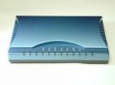
MODEM
It is a computer peripheral that allows you to connect and communicate with other computer via telephone line.
Modem changes the digital data from your computer into analog data, a format that can be carried over telephone lines.
In the same way the modem receiving the call then changes the analog signal back into digital data that the computer can understand.

Slide 19
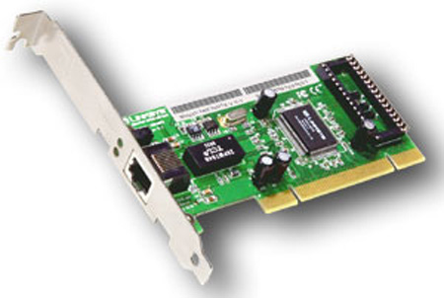
ETHERNET CARD
Type of LAN card developed by Xerox Corp. along with DEC and Intel.
It uses a Bus or Star topology.
Supports data transfer rates of up to 10 Mbps and more

Slide 20
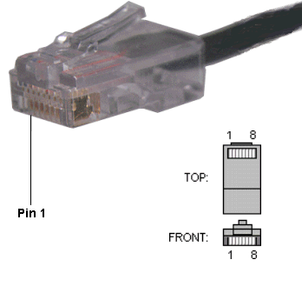
RJ-45 CONNECTOR
The Registered Jack-45 connector is commonly used for network cabling and for telephony applications.
It is an eight wire connector which is commonly used to connect computers on the local area networks, especially Ethernets.
It is similar to telephone connector RJ-11 except that it has eight wires as compared to 4 in RJ-11.

Slide 21
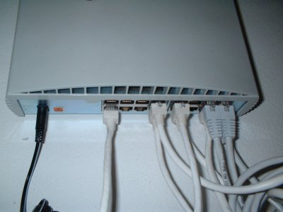
HUB
It is used to connect several computers together.
A network device the information flow is accumulated and then distributed to various groups and users.
It can be between users on the same LAN
It is often used in Star or Ring topology.

Slide 22
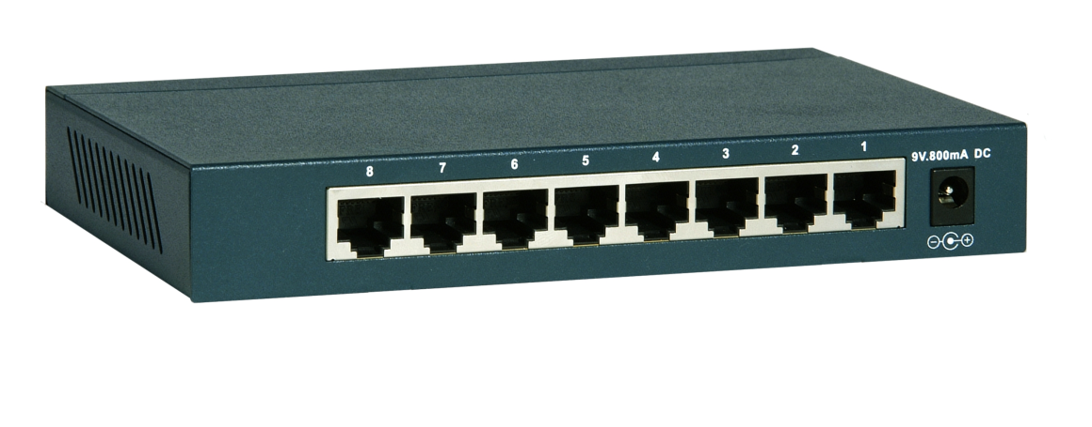
SWITCH
A network switch is a computer networking device that connects network segments.
Network switches appear nearly identical to network hubs, but a switch contains more "intelligence" (and comes with a correspondingly slightly higher price tag) than a network hub. Network switches are capable of inspecting data packets as they are received, determining the source and destination device of that packet, and forwarding it appropriately. By delivering each message only to the connected device it was intended for, a network switch conserves network bandwidth and offers generally better performance than a hub.
Switches differ from hubs in that they can have ports of different speed.

Slide 23
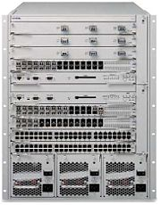
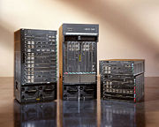

ROUTER
A router is a computer whose software and hardware are usually tailored to the tasks of routing and forwarding packets
This device routes the information packet between two or more physically or logically connected networks.
It is different from a Switch as this uses a logical address while bridge uses a MAC address.

Slide 24
BRIDGE (Early form of a Switch)
It is a device that lets you link two same networks together.
Same networks mean networks with same protocol.
REPEATER
It is a device that amplifies and restores a signal being transmitted on the network.
It is used in long network lines.

Slide 25
GATEWAY
This device usually a server is used to communicate between dissimilar networks i.e. networks with different protocols.
e.g. to connect a LAN with Novell Netware with another LAN with Microsoft NT.
In enterprises, the gateway is the computer that routes the traffic from the workstation to the outside world.
In homes, the gateway is the ISP that connects the user to the Internet.

Slide 26
Research Exercise:
For next week investigate the following acronyms:
TCP/IP
FTP
HTTP
PPP
Telnet

Slide 27
PROTOCOL
Protocol is a standard set of rules that govern how computer communicates with each other. Protocol determines both the format that a message must take and the way in which messages are exchanged between computers. Protocols may be implemented by hardware, software, or a combination of the two.
Some of the common protocols used on the Internet are:
TCP/IP
FTP
HTTP
PPP
TELNET

Slide 28
TCP/IP (Transmission Control Protocol/Internet Protocol)
TCP breaks the data into packets that the network can handle efficiently, verifies that all the packets arrive at their destination and then reassembles the data. IP allots the destination address to the packets and also allots the sequence numbers.
For example, when an html file is sent to you from a Web server, the TCP program layer of that server takes the file and divides it into packets, numbers the packets, and then forwards them individually to the IP program layer. Even though every packet has the same destination IP address, they can get routed differently through the network. When the client program in your computer gets them, the TCP reassembles the individual packets and waits until all of those files have arrived before giving them to an application as one single file.

Slide 29
FTP (File Transfer Protocol)
Protocol which enables files to be transferred from one computer to another. i.e. Downloading and Uploading of files.
FTP runs exclusively over TCP.
HTTP (Hyper Text Transfer Protocol)
Protocol used to transfer hypertext files. Hypertext is an ordinary text that has some extra features such as formatting, images, multimedia and links to other documents.
HTTP is not constrained to using TCP/IP.

Slide 30
PPP (Point to Point Protocol)
PPP, is a data link protocol commonly used to establish a direct connection between two nodes over serial cable, phone line, cellular telephone, specialized radio links, or fiber optic links. Most Internet service providers use PPP for customers' dial-up access to the Internet.
TELNET (Remote Login)
TELNET (TELecommunication NETwork) is a network protocol used on the Internet or local area network (LAN) connections.
Telnet is the main Internet protocol for creating a connection with a remote machine. It gives the user the opportunity to be on one computer system and do work on another, which may be across the street or thousands of miles away. In WWW publishing telnet is used to log into the web server and 'set the permissions' of files and directories. To start a Telnet session, you must log in to a server by entering a valid username and password. Telnet is a common way to remotely control Web servers.

Slide 31
WIRELESS/MOBILE COMMUNICATION TECHNOLOGIES
WLL (Wireless in local Loop) : It is system that connects subscribers to the public switched telephone network (PSTN) using radio signals as a substitute for copper for all or part of the connection between the subscriber and the switch.
GSM (Global System for Mobile Communication):
European standard
Expensive
Used by 70% of the world
In operation for about 15 years
Uses the 3G services technology for supporting database and multimedia features.
Operates on TDMA technology (Time Division Multiple Access)
Idea and Airtel are using GSM

Slide 32
CDMA (Code Division Multiple Access)
American standard
Cheaper
It is designed by a company called Qualcomm.
Same handset cannot be used for both CDMA and GSM.
High Bandwidth
  which supports wireless data services and application such as wireless e-mail, web, digital pictures taking and sending.
  better voice quality
  environment interference has less effect
Reliance, TATA are using CDMA technology

Slide 33
3G Technology (3rd Generation Technology)
3G is a generation of mobile phone standards and technology after 2G.
The first nation to implement 3G technology was Japan.
Is used to facilitate data services and applications such as wireless e-mail, web (downloading data), Multimedia messaging, digital picture sending/receiving.
Provides high bandwidth.
SMS (Short Message Service)
SMS is the ability to send and receive text messages to and from mobile telephones.
The text can comprise of words or numbers or an alphanumeric combination.
SMS was created as a part of the GSM Phase – 1 standard.
The first short message is believed to have been sent in December 1992 from a Personal Computer (PC) to a mobile phone on the Vodafone GSM network in the UK.

Slide 34
Voice Mail
A system that answers calls and allows users to reply to, save, delete or forward messages.
A computerised, highly sophisticated answering service that automatically answers your call, plays a greeting in your own voice and records a message. Depending on the sophistication of the service, it can also notify you via a pager that you have received a call. After you have retrieved your messages, you can delete them, save them, reply to them or forward them to someone else on your voice mail system.

